Slide 1

Tau Beta Pi
The National Engineering Honor Society
University of Colorado at Boulder
Colorado Beta Chapter

Slide 2
Who We Are/History
All-Encompassing Engineering Honor Society
National Organization
  Founded 1885
  Largest Engineering Honor Society
Local Chapter
  Founded in 1905, second chapter in Colorado
  Over 4,500 Total Members
Notes:
Becoming a member of Tau Beta Pi is a great honor. It means that you are in the top 1/8th of the Junior class or the top 1/4th of the Senior class. You will join many successful engineers in becoming a member of this society.
Former President of McDonnell Douglass, Livingston Farrand, Milo Ketchum, President of Lockheed Martin
Many of the CEO’s of major corporations have affiliations with TBP.

Slide 3

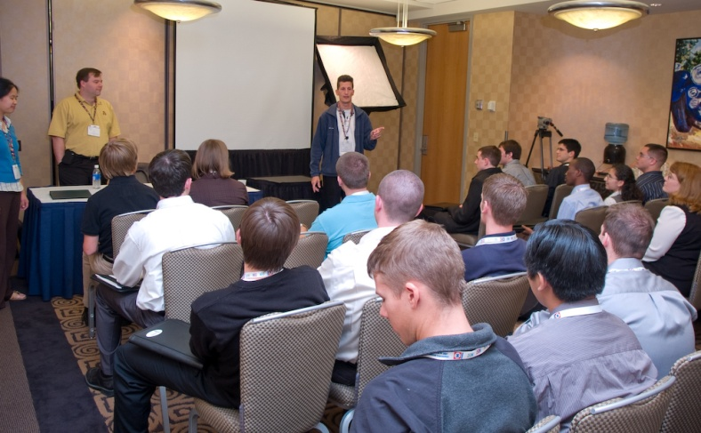


Local Activities
Professional Development
  Engineering Futures
  Opportunities/Networking
  Company Presentations
  & Exclusive Recruitment
Notes:
Engineering Futures are professional development courses that deal with interpersonal relationships and working with others, either as teams or in other group settings. Fortune 500 companies pay thousands, but we get them for free. Make you more marketable to employers. Curriculum: People skills, Team chartering, Group Process, Analytical Problem Solving, Effective Presentation Skills

Slide 4
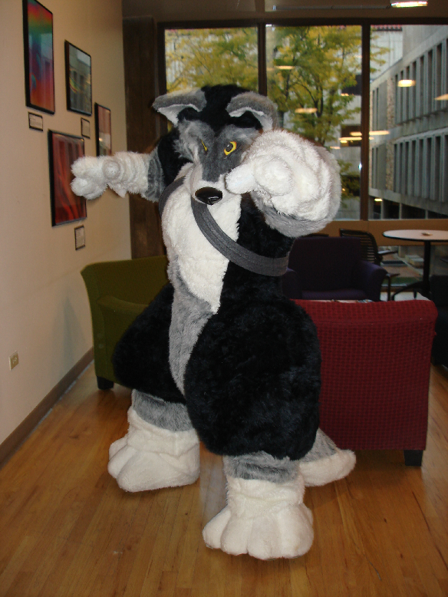
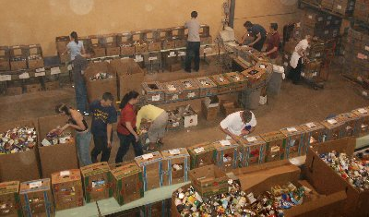
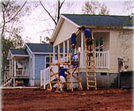

Local Activities
Community Service
  Trick Or Can [Fall]
  Habitat for Humanity
  Relay for Life
  Colorado Food Share
Notes:
Character is also very important to Tau Beta Pi. We try and host a group volunteer event once a semester.

Slide 5
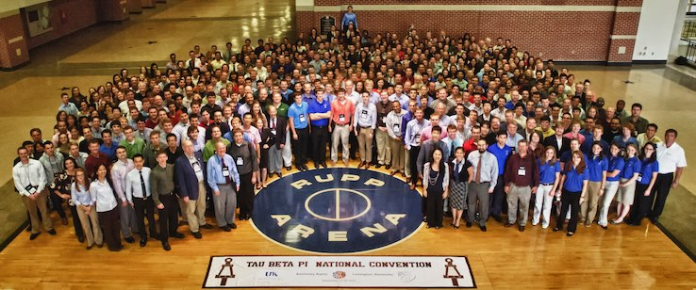
National / District Activities
National Convention
District Conference
  Meet engineers from all over the country
  Exchange ideas
  Network!

Slide 6


National Organization- Benefits
Scholarships
    $2000/year
    Often ~ 50% chance of receiving one!
Fellowships
    $10,000/year
    30 Awarded last year
Student Loans
    Up to $2500
Career Assistance
Networking and Mentoring
Publications
    The Bulletin and The Bent
Other Discounts and Benefits!
  Geico discount, FE exam review discounts

Slide 7


How to Become a Member
Top 1/8 of Juniors or 1/5 of Seniors are eligible to become members!
Additional Requirement for Membership:

Slide 8
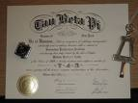
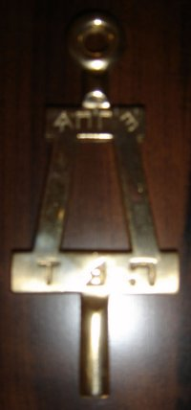
How To Become a Member
You already meet the academic req.
Next Steps:
  Interview with an Officer
    Sign Up Now!
  Creativity Projects: Feb. 23rd & 24th
  Community Service Project
    Complete before initiation or write up recent past experience
  Polish Bent
    You will receive one during creativity project presentation

Slide 9
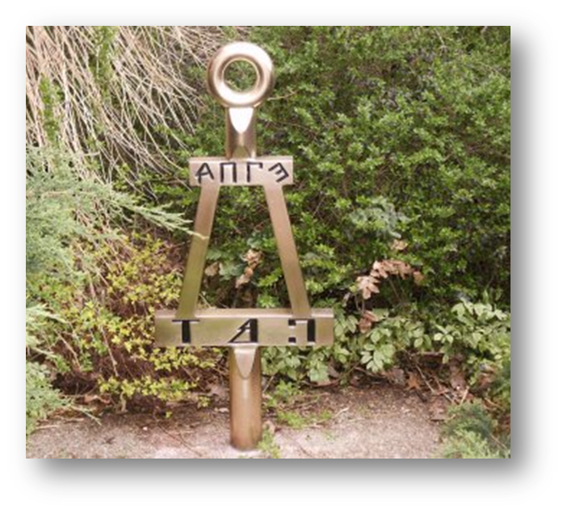
Initiation
  Ceremony Sunday, Mar. 15th
    Banquet provided
  $90 Lifetime Fee

Slide 10
Contact Information
Feel free to email us if you have any questions!
President:
Amber Lane
Amber.Lane@colorado.edu
Vice-President:
Andy Kim
Jihoon.Kim@colorado.edu

